Slide 1


IRWAN INDUSTRIES
FINAL PROJECT
HR
ANALYSIS

Slide 2

INTRODUCTION
This project consists in a company HR data driven insights related to employees attrition.
The method used consists in the following steps: Business Understanding, Analytical Approach, Data Understanding and Analysis, and Suggestion.

Slide 3
TABLE OF CONTENTS
Business Understanding
Analytical Approach
Selecting Features
Exploratory Analysis
Machine Learning Model
Department and Job Analysis
Research and Development
Human Resources
Sales
Suggestions

Slide 4

BUSINESS UNDERSTANDING
SCENARIO
The key to success in any organization is attracting and retaining top talent. As an HR analyst, one of the key tasks is to determine which factors keep employees at the company and which prompt others to leave.
QUESTION
How can we identify and enhance key factors to retain top talent?

Slide 5

ANALYTICAL
APPROACH
GOAL
EXPLORATORY ANALYSIS
ML MODEL
Select important features.
Correlation and Analysis
Implement Random Forest
GOAL
EXTRACT
KNOWLEDGE
Provide HR Insights.
Extract kowledge from the selected features.

Slide 6

SELECTING FEATURES
EXPLORATORY ANALYSIS
NUMERICAL FEATURES
CORRELATION AMONG FEATURES
INDIVIDUAL ATTRITION ANALYSIS
CATEGORICAL FEATRUES
INDIVIDUAL ATTRITION ANALYSIS
SELECT EA IMPORTANT FEATURES
CORRELATION TABLE

Slide 7
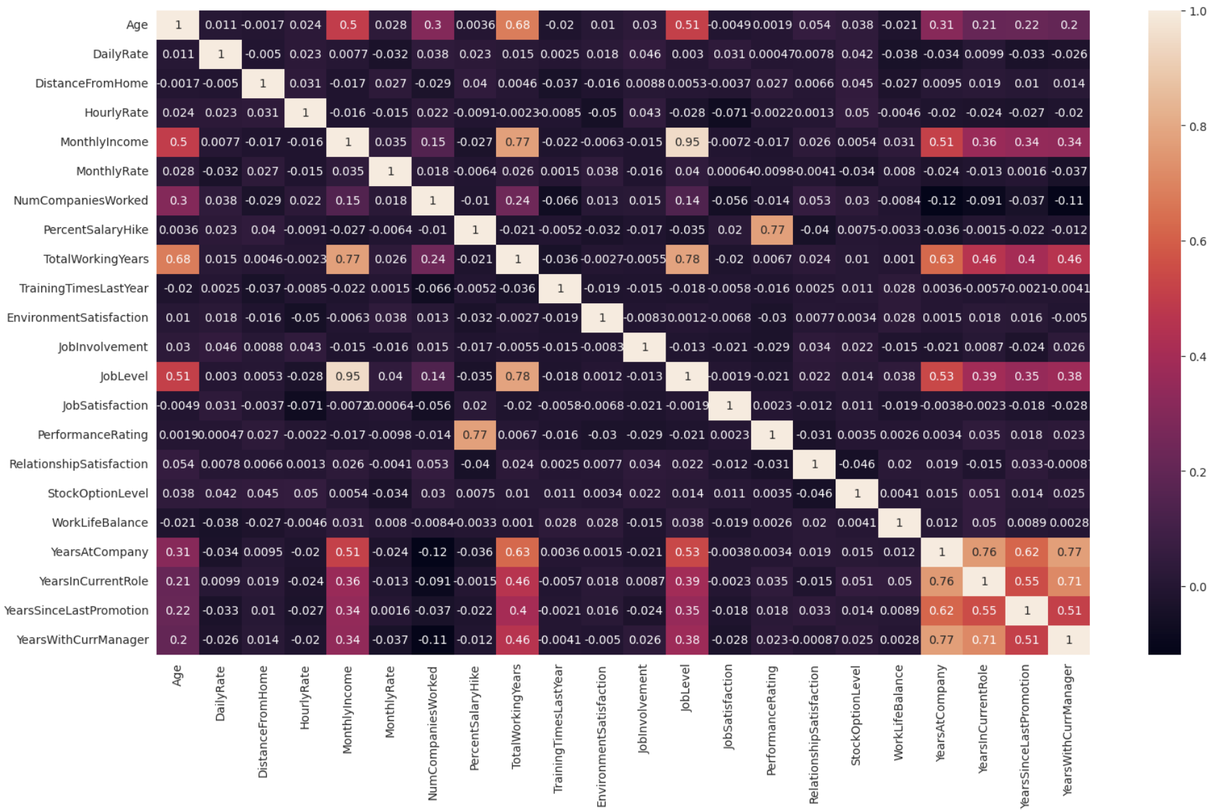
EXPLORATORY ANALYSIS
NUMERICAL FEATURES - CORRELATION AMONG FEATURES

Slide 8
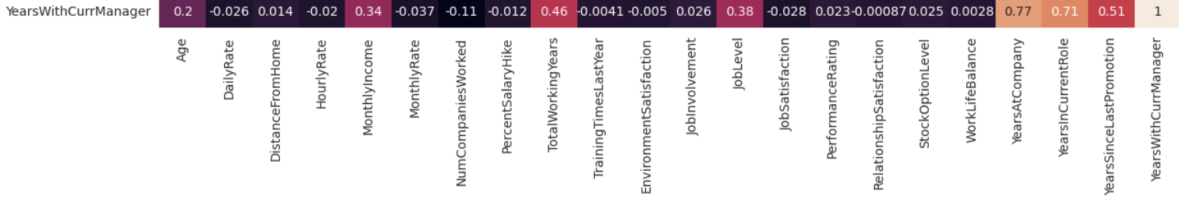
EXPLORATORY ANALYSIS
NUMERICAL FEATURES - CORRELATION AMONG FEATURES
DROPPING
YEARSWITHCURRMANAGER / YEARSATCOMPANY (0.77)
YEARSWITHCURRMANAGER / YEARSINCURRENTROLE (0.71)
COMBINING
YEARSATCOMPANY + YEARSINCURRENTROLE
STAGNATION

Slide 9

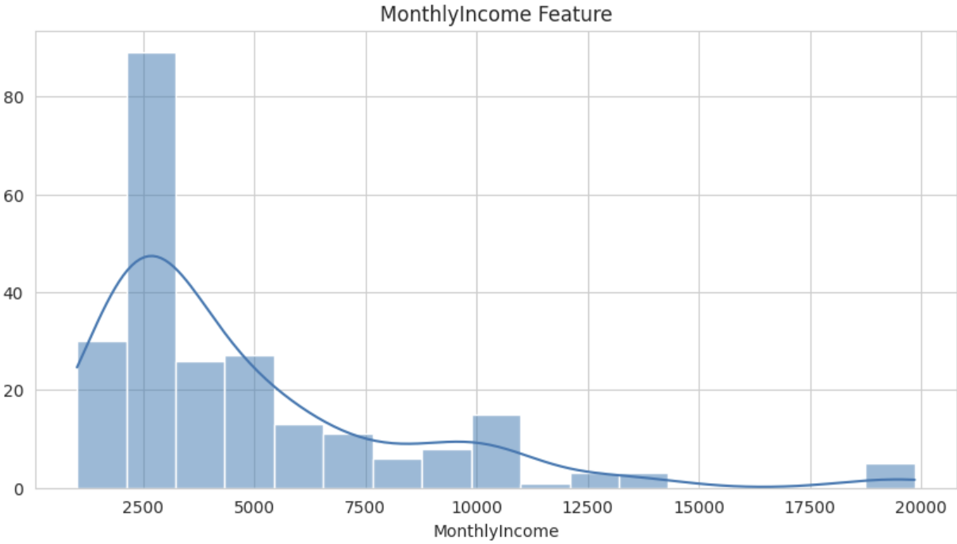
EXPLORATORY ANALYSIS
NUMERICAL FEATURES - INDIVIDUAL ATTRITION ANALYSIS
HISTOGRAM

Slide 10
EXPLORATORY ANALYSIS
NUMERICAL FEATURES - INDIVIDUAL ATTRITION ANALYSIS
ATTRITION CORRELATION
CORRELATION = -0.15983958238498874
P-VALUE = 7.147363985353831 E-10

Slide 11
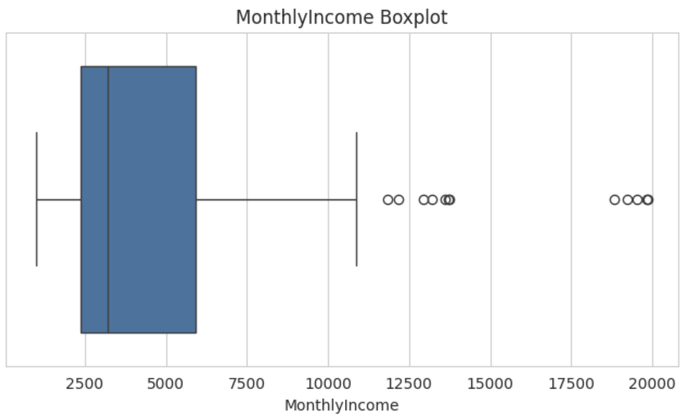
EXPLORATORY ANALYSIS
NUMERICAL FEATURES - INDIVIDUAL ATTRITION ANALYSIS
BOXPLOT

Slide 12
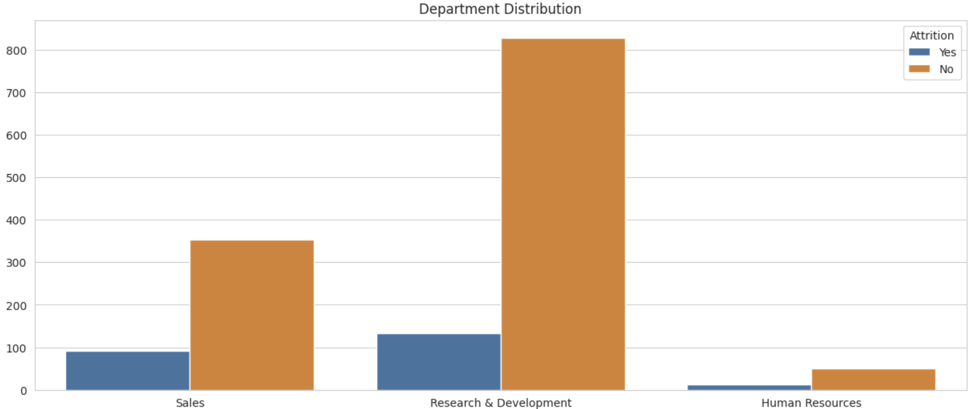
EXPLORATORY ANALYSIS
CATEGORICAL FEATURES - INDIVIDUAL ATTRITION ANALYSIS
BAR CHART

Slide 13
EXPLORATORY ANALYSIS
CATEGORICAL FEATURES - INDIVIDUAL ATTRITION ANALYSIS
ATTRITION CORRELATION
CORRELATION = 0.12287973746788898

Slide 14
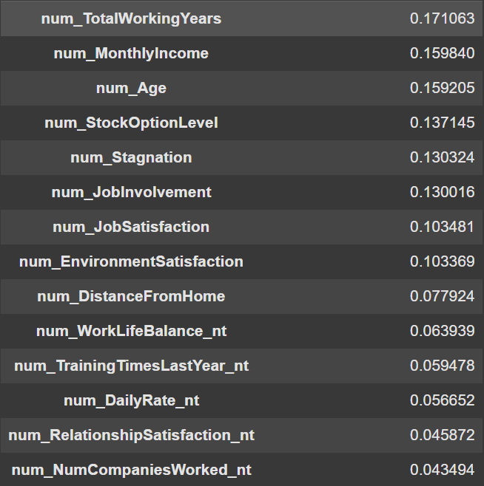
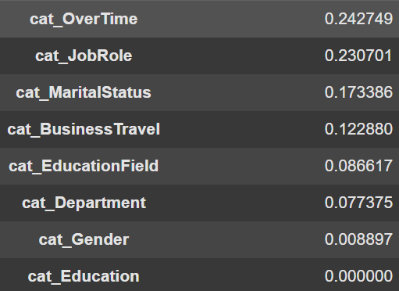
EXPLORATORY ANALYSIS

Slide 15
SELECTING FEATURES
MACHINE LEARNING MODEL
BUILD RANDOM FOREST
OVER SAMPLING
SEPARETE TRAIN/TEST GROUPS
MODEL FITTING
VALIDATION
CROSS VALIDATION
EXTRACT RF IMPORTANT FEATURES

Slide 16
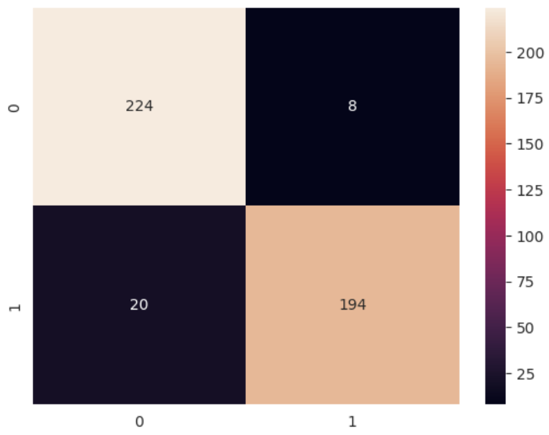

MACHINE LEARNING MODEL
VALIDATION
SCORES
RANDOM FOREST ACCURACY SCORE: 93.72 %
RANDOM FOREST RECALL SCORE: 90.65 %
RANDOM FOREST PRECISION SCORE: 96.04 %
RANDOM FOREST F1-SCORE: 93.27 %

Slide 17
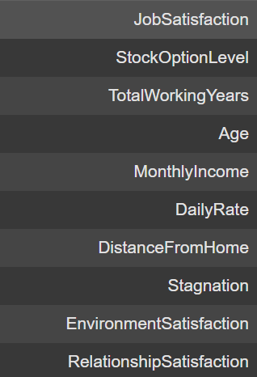
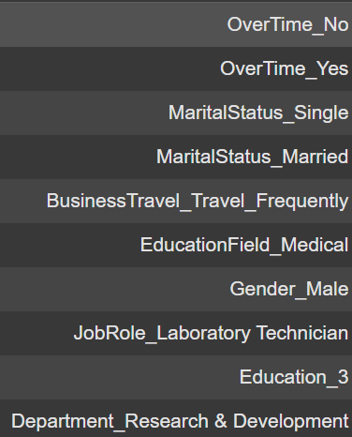
MACHINE LEARNING MODEL
EXTRACT RF IMPORTANT FEATURES

Slide 18
SELECTING FEATURES
EXPLORATORY ANALYSIS
SELECTED FEATURES
MACHINE LEARNING MODEL

Slide 19
SELECTING FEATURES
DISTANCEFROMHOME
TOTALWORKINGYEARS
MONTHLYINCOME
STOCKOPTIONLEVEL
JOBSATISFACTION
DEPARTMENT
OVERTIME
JOBROLE
BUSINESSTRAVEL

Slide 20

DEPARTMENT AND JOB ROLES ANALYSIS
NUM METRICS
CAT METRICS
DistanceFromHome
TotalWorkingYears
MonthlyIncome
StockOptionLevel
JobSatisfaction
OverTime
BusinessTravel

Slide 21
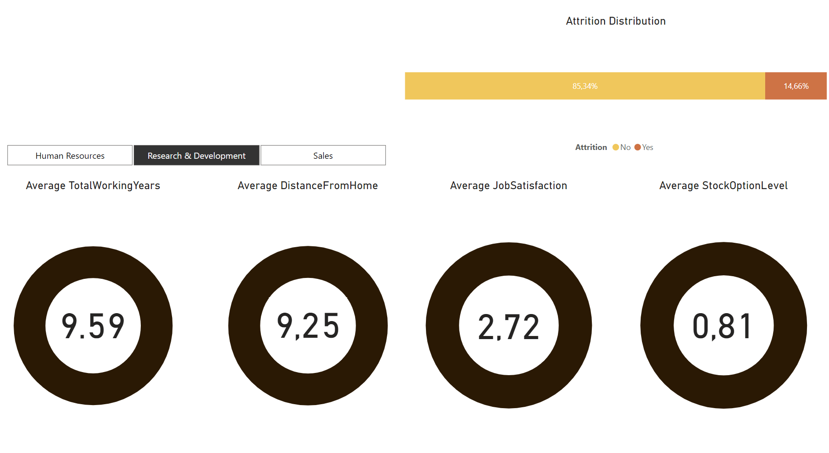
RESEARCH & DEVELOPMENT
GENERAL METRICS

Slide 22
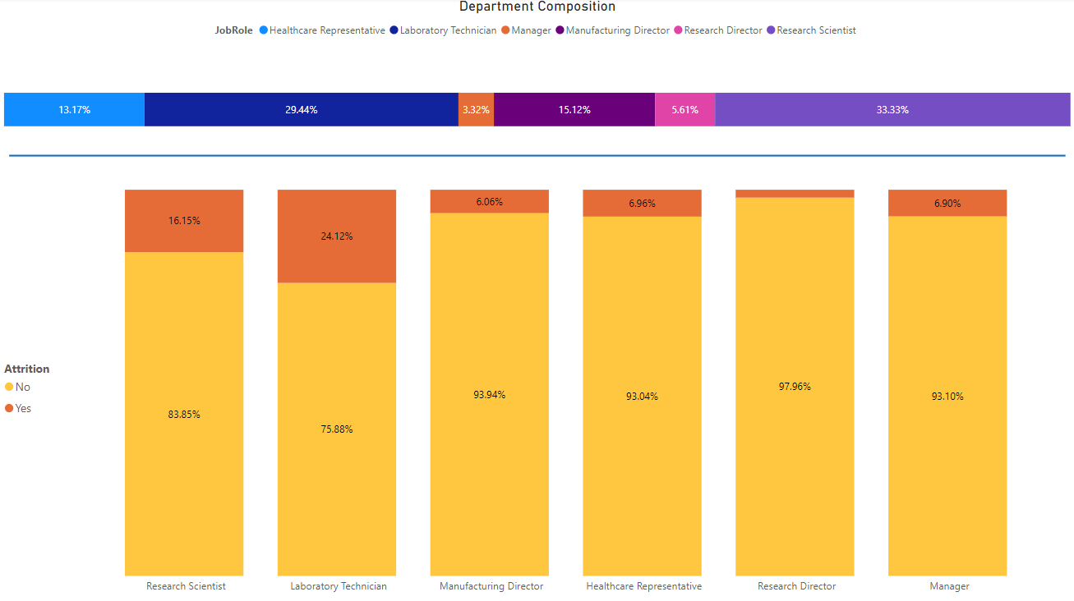
RESEARCH & DEVLOPMENT

Slide 23
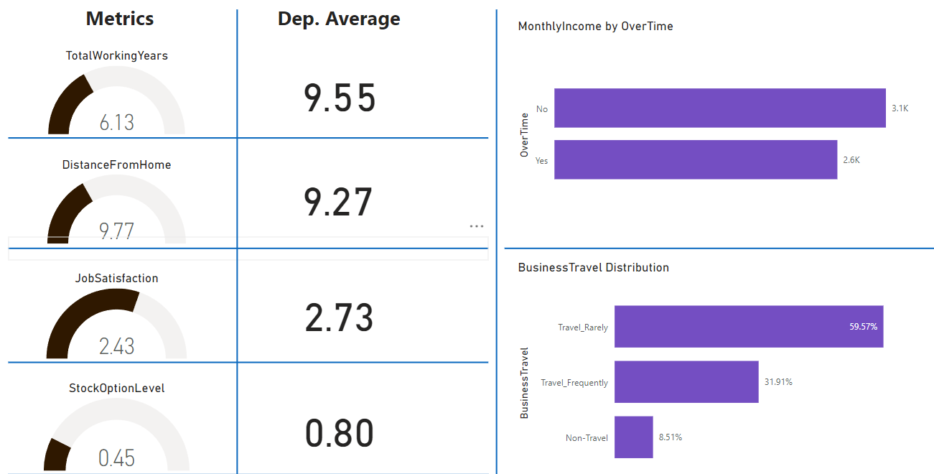
RESEARCH SCIENTIST

Slide 24
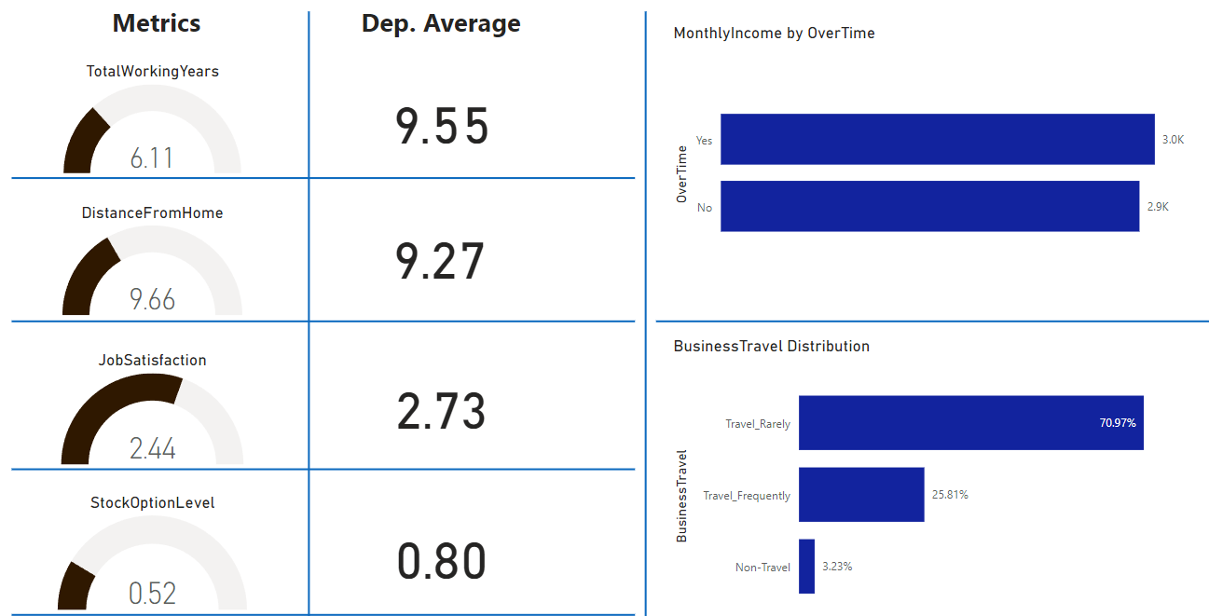
LABORATORY TECHNICIAN

Slide 25
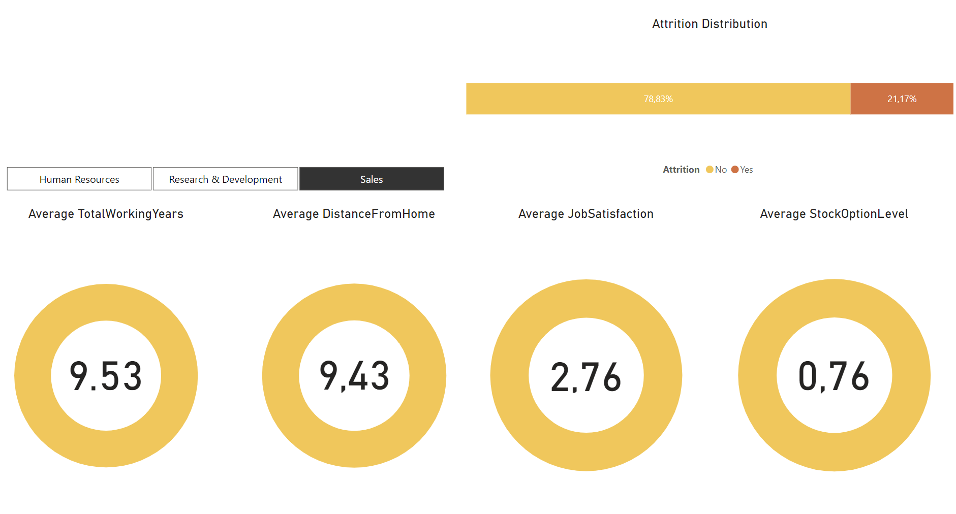
SALES
GENERAL METRICS

Slide 26
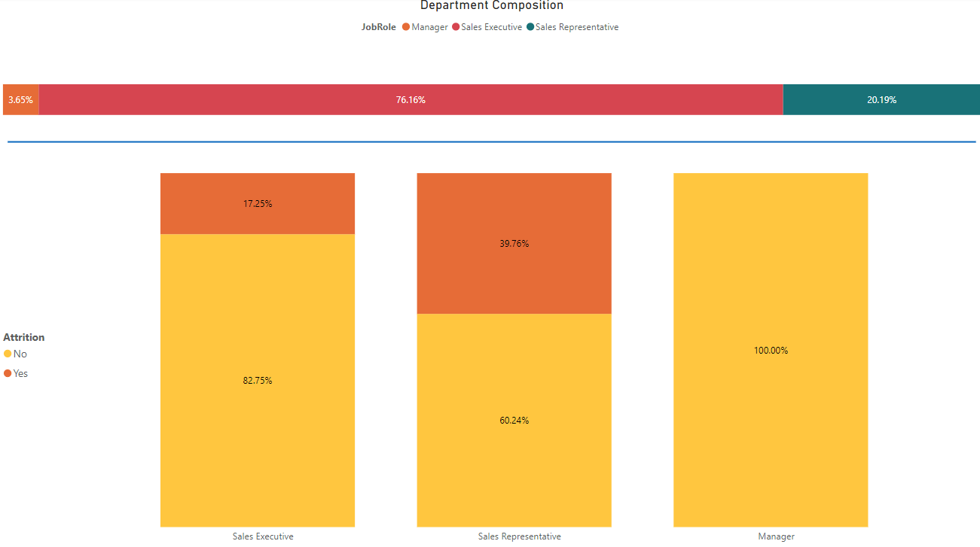
SALES

Slide 27
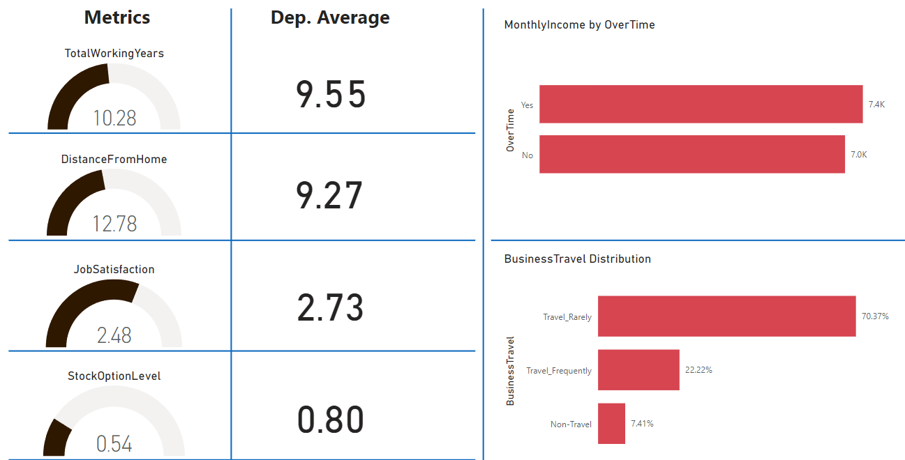
SALES EXECUTIVE

Slide 28
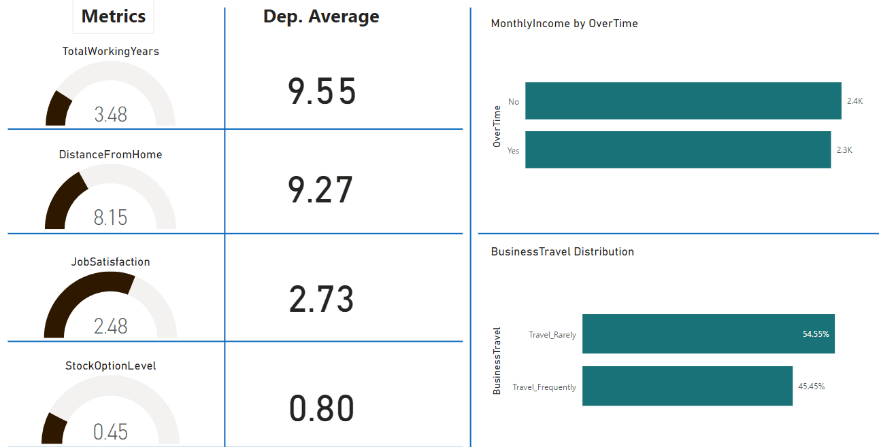
SALES REPRESENTATIVE

Slide 29
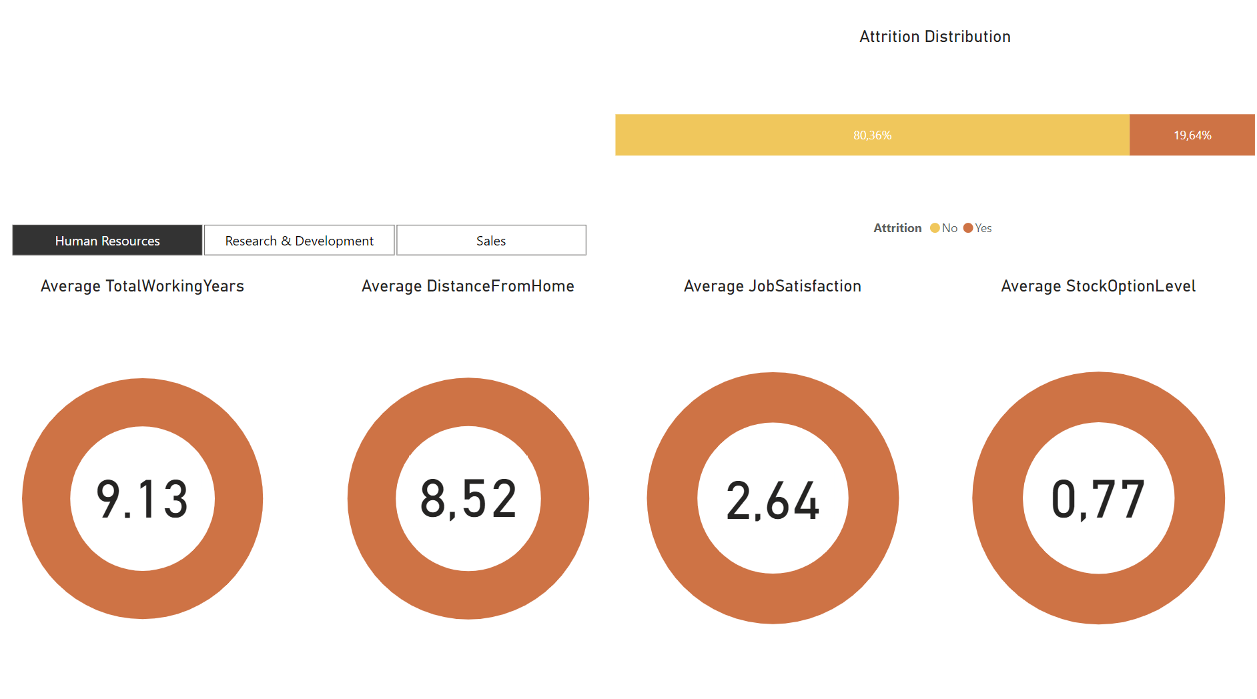
HUMAN
RESORCES
GENERAL METRICS

Slide 30
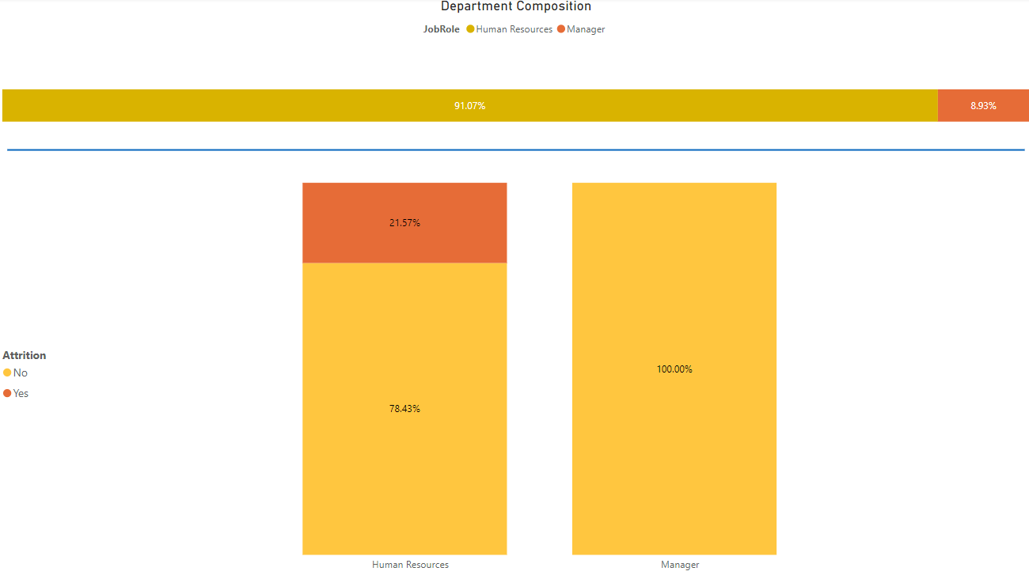
HUMAN
RESORCES

Slide 31
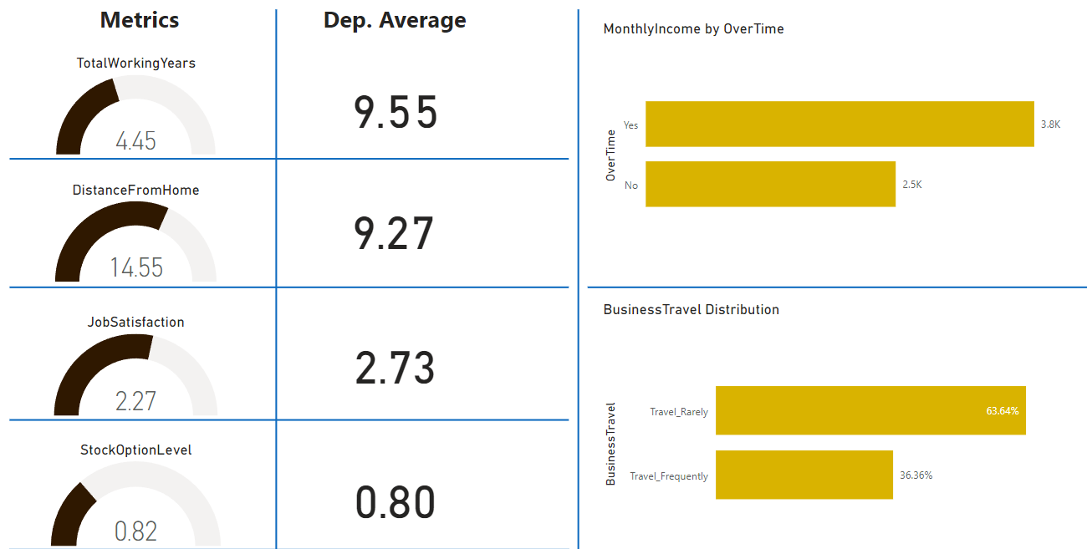
HUMAN RESOURCES

Slide 32


SUGGESTIONS
OVERALL SUGGESTIONS
Improve business travel situation
Pay overtimes properly
Use Job Satisfaction forms for better understanding of the employees situation
Use Stock Option offers as a retaining option
INDIVIDUAL SUGGESTIONS
Laboratory Technician / Research Scientist / Sales Rep.
Hire more experienced employee (Increase TotalWorkingYears Average)
Human Resorces / Sales Executive
Hire employee who lives close to the company

Slide 33

IRWAN INDUSTRIES
THANK YOU

